Slide 1


Read – listen & watch
Strategic consulting, marketing
Media Kit

Slide 2

ABOUT US
Travel News Group offers a complete solution for communication, marketing, and visibility
Travel News Group is the publisher of eTurboNews is the oldest and largest 24/7 online newswire publication for travel and tourism in the world
16 Destination Editions and Syndication Publications
Hourly global email and push notification updates
230,000 travel industry professionals read eTurboNews daily
More than 2 million readers combined every month
Published worldwide in 102+ languages
Extensive syndication
News aggregators include Google-, Bing-, Yahoo News
Extensive social media network on Twitter, Telegram, Facebook, LinkedIn
Chat groups on WhatsApp, Telegram, Facebook & LinkedIn
Published on independent searchable news language portals
Breaking News Video show (Zoom, TV, YouTube, Vimeo)
Partner: Travel Marketing Network - communication, visibility & consulting & training

Slide 3

HISTORY
Travel News Group started with eTurboNews in 1999 as a Yahoo discussion group and a sponsor by the name of eTurboHotels, the first online booking engine for hotels based in Singapore.
Facilitated the Yahoo discussion group for ASEAN Tourism and the Hawaii Tourist Network.
First online media for the global travel and tourism industry.
First online media partners with most major and not-so-major travel and tourism trade shows, including ITB, World Travel Market, IMEX, and many more.
A global network of contributors.
Founding member of the CNN Task Group together with UNWTO, IATA, and CNN.

Slide 4

- First online publication in the world since April 1999
- reaching 2+ million in 102 languages 24/7
- Foremost online news venue for close to 200,000 travel industry professionals everywhere in the world
- Critical, unique, trustworthy
FLAGSHIP PUBLICATION

Slide 5

- TravelWireNews was launched first in 2011 and relaunched 2024 a SHORT NEWS to summarize press releases in 100-300 words
- reaching all eTurboNews subscribers and an increasing number of visitors due to Google, Bing, and other search positionings
- easy to read for the busy travel industry professional

Slide 6
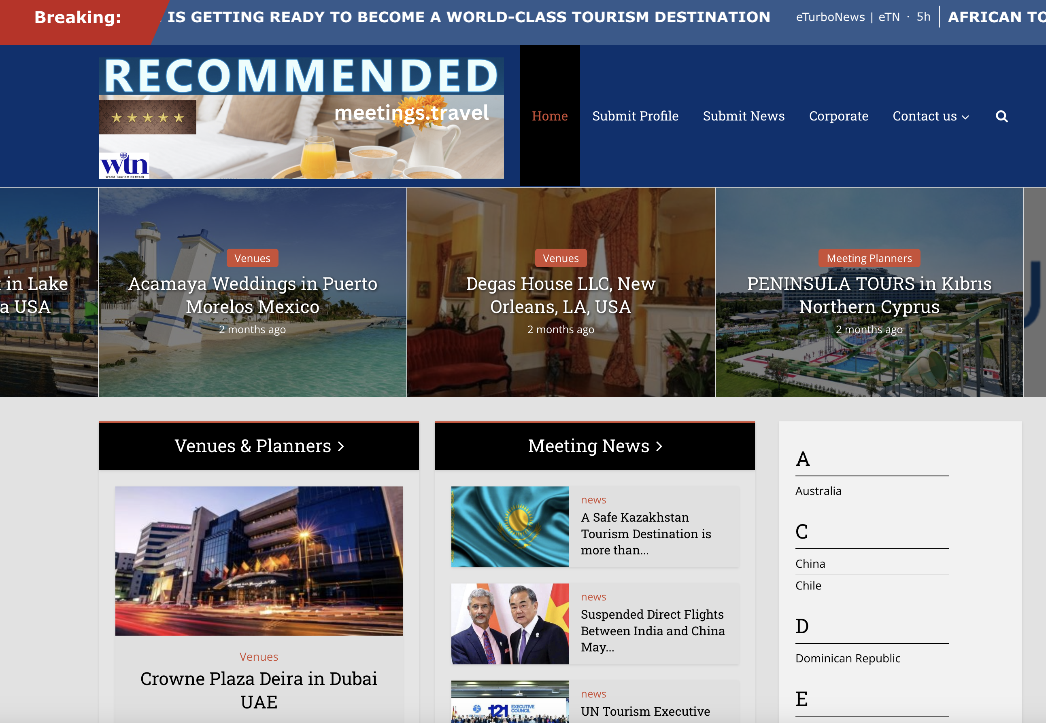
- Meetings.travel was launched 10 years ago during IMEX to inform providers of the Meeting and Incentive industry AND reach out to potential buyers
- in cooperation with the reach of eTurboNews, content published to showcase convention centers, MICE venues and suppliers link to the profile on meetings. travel
- It provides your profile a potential audience of millions .
- Meetings.travel also teamed up with business-travel.de, one of the most known publication promoting the MICE industry.

Slide 7

APPLY to be awarded our
TOURISM WITH PASSION SEAL.
It’s free and comes with a searchable profile page on eTurboNews.
The seal will be embedded on all press releases you publish with us and link to your profile page.
It’s our way of recognizing outstanding businesses, destinations, and people.
This is FREE!

Slide 8



INHOUSE SYNDICATION

Slide 9
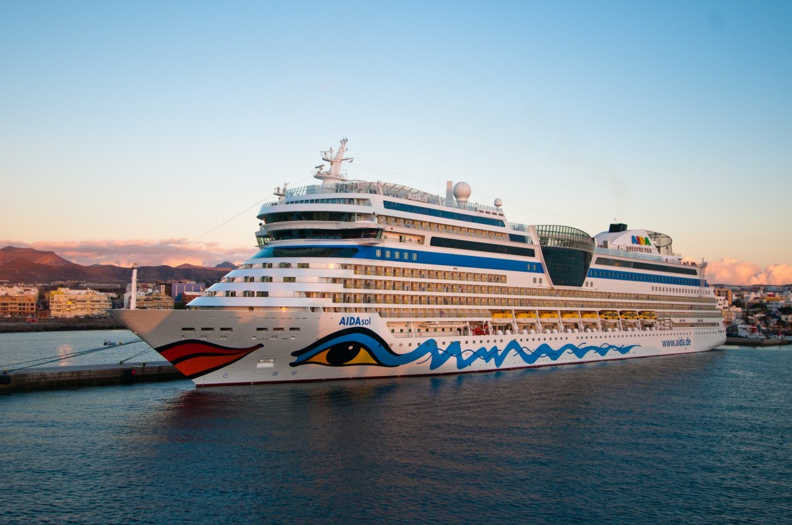


MORE MEMBER PUBLICATIONS

Slide 10



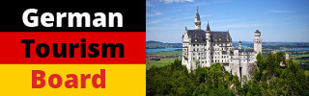
MORE MEMBER PUBLICATIONS

Slide 11
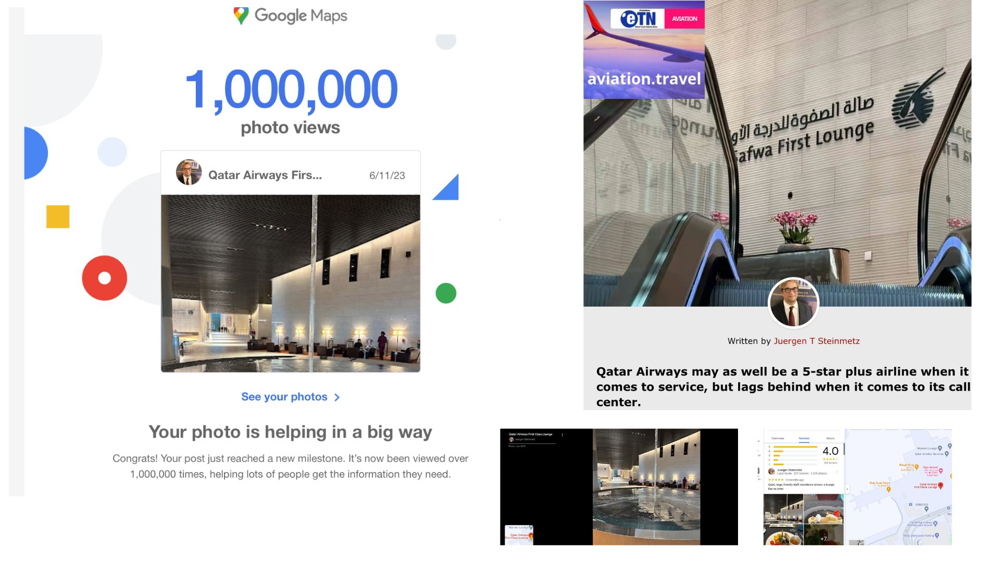
SOCIAL MEDIA & CHAT GROUPS
YOUTUBE
VIMEO
Facebook Pages
Facebook Groups
LinkedIn
Instagram
Twitter
Yandex
Telegram
Vimeo
Pinterest
WhatsApp Chat Groups

Slide 12
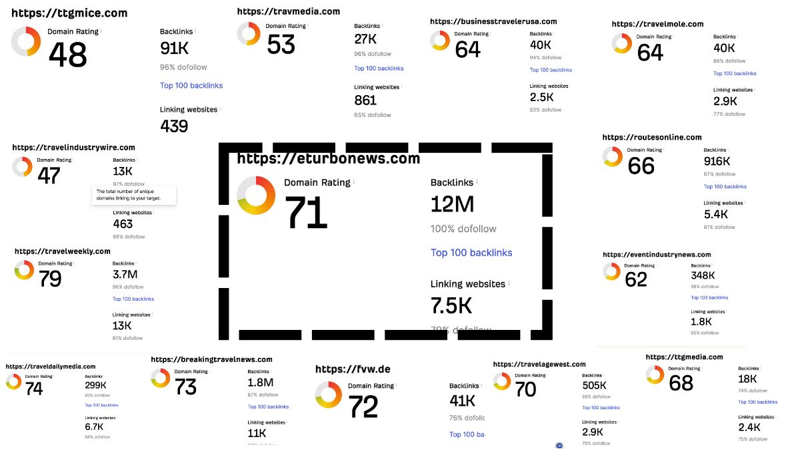
RATINGS
Among all major travel industry publications, eTurboNews is number 1 with backlinks, all are 100% do-follow links.
We're number 3 in linking to relevant story sources and 5 in overall news portal ranking.
Considering 106 independent language sites under the eTurboNews domain, this ranking for some of our primary languages is likely higher.

Slide 13

REACH
2.06 million unique readers
Travel trade Readers:
180,000 travel
10,000 journalists
Email trade newsletters: 152,000 readers
Push notification: 418,000 followers
RSS feeds: 52,000
Published in 102 languages on independent portals
Google & Search -rated in local and global markets
Written content converted into audio and video
24/7 online Video News Channel and Shows
Google & Bing News +++
Extensive Social Media & Chat Groups

Slide 14
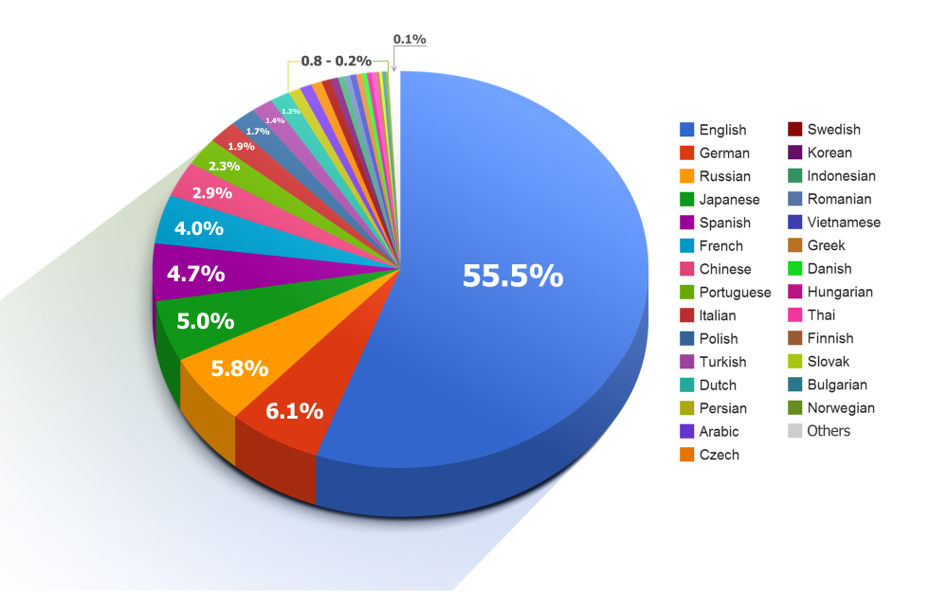
Languages
Albanian
Amharic
Arabic
Armenian
Azerbaijani
Basque
Belarusian
Bengali
Bosnian
Bulgarian
Catalan
Cebuano
Chichewa
Chinese (Simplified)
Chinese (Traditional)
Corsican
Croatian
Czech
Danish
Dutch
English
Esperanto
Estonian
Filipino
Finnish
French
Frisian
Galician
Georgian
German
Greek
Gujarati
Haitian Creole
Hausa
Hawaiian
Hebrew
Hindi
Hmong
Hungarian
Icelandic
Igbo
Indonesian
Irish
Italian
Japanese
Javanese
Kannada
Kazakh
Khmer
Korean
Kurdish
Kyrgyz
Lao
Macedonian
Malagasy
Malay
Malayalam
Maltese
Maori
Marathi
Mongolian
Burmese
Nepali
Norwegian
Pashto
Persian
Polish
Portuguese
Punjabi
Romanian
Russian
Samoan
Scottish Gaelic
Serbian
Sesotho
Shona
Scottish Gaelic
Serbian
Sesotho
Shona
Sindhi
Sinhala
Slovak
Slovenian
Somali
Spanish
Sudanese
Swahili
Swedish
Tajik
Tamil
Telugu
Thai
Turkish
Ukrainian
Urdu
Uzbek
Vietnamese
Welsh
Xhosa
Yiddish
Yoruba

Slide 15

Readers by Country & Regions
USA: 1,289,335
UK: 217,861
Germany: 202,715
India: 97,647
Canada: 82,307
Philippines: 65,081
South Africa: 54,047
Italy: 49,548
Sweden: 46,242
China: 40,804
Australia: 40,165
Portugal: 30,215
Thailand: 27,627
Norway: 27,556
UAE: 27,369
Singapore: 26,168
Netherlands: 25,999
France: 25,409
Malaysia: 20,117
Spain: 19,492
Kenya: 16,734
Japan: 14,907
Greece: 6,962
Zimbabwe: 6,501
Austria: 6,284
Denmark: 6,276
Ethiopia: 6,212
Egypt: 6,103
Ukraine: 6,009
Uganda: 5,992
Bangladesh: 5,598
Romania: 5,505
New Zealand: 5,490
Czechia: 5,333
Qatar: 5,174
Taiwan: 5,004
Bulgaria: 4,793
Hungary: 4,441
Croatia: 4,267
Trinidad & Tobago: 4,196
Uzbekistan: 4,084
Seychelles: 4,044
Serbia: 4,023
Russia: 14,135
Finland: 14,106
Pakistan: 13,965
Jamaica: 12,462
Turkey: 12,376
Indonesia: 11,849
Vietnam 11,211
South Korea: 10,887
Brazil: 10,469
Mexico: 9,810
Israel: 9,282
Nigeria: 9,194
Saudi Arabia: 8,922
Switzerland: 8,850
Ireland: 8,541
Belgium: 8,496
Poland: 8,179
Hong Kong: 8,117
Sri Lanka: 7,168
Zambia: 7,159
Iran: 7,042

Slide 16
Readers by Country & Regions
Georgia: 3,806
Slovakia: 3,795
Kazakhstan: 3,773
Nepal: 3,289
Malta: 3,167
Ghana: 3,005
Cyprus: 2,928
Oman: 2,879
Mauritius: 2,876
Barbados: 2,857
Estonia: 2,766
Latvia: 2,712
Argentina: 2,700
Colombia: 2,561
Mongolia: 2,429
Morocco: 2,389
Puerto Rico: 2,300
Bahrain: 2,216
Jordan: 2,193
Slovenia: 2,108
Albania: 2,087
Kuwait: 2,084
Azerbaijan: 2,063
Cambodia: 2,040
Lithuania: 2,020
Bahamas: 1,914
Iraq: 1,899
Lebanon: 1,839
Armenia: 1,787
Myanmar: 1,778
Dominican Republic: 1,734
Chile: 1,721
North Macedonia: 1,660
Costa Rica: 1,631
Botswana: 1,493
Algeria: 1,440
Somalia: 1,419
Maldives: 1,364
Peru: 1.340
Guam: 1,325
Tunisia: 1,305
Laos: 1,294
Grenada: 1,238
St. Lucia: 1,160
Bosnia & Herzegovina: 1,145
Rwanda: 1,104
Iceland: 1,061
Antigua & Barbuda: 1,023
Kosovo: 1,019
Panama: 972
Kyrgyzstan: 961
Ecuador: 946
Mozambique: 906
Eswatini: 894
Luxembourg: 868
US Virgin Islands: 718
Malawi: 716
Venezuela: 696
Brunei: 689
St. Kitts & Nevis: 688
Belarus: 676
Afghanistan: 669
Cayman Islands: 659

Slide 17
Readers by Country & Regions
Belize: 637
Montenegro: 633
Senegal: 633
Guyana: 623
Cameroon: 619
Bermuda: 611
Sudan: 605
Cote d’Ivoire: 597
Moldova: 567
Macao: 560
Aruba: 559
Curacao: 526
Syria: 523
Congo – Kinshasa: 514
Solomon Islands: 477
Guatemala: 466
Libya: 458
Sint Maarten: 434
Fiji: 428
Angola: 426
Lesotho: 406
South Sudan: 396
Cuba: 394
Yemen: 386
Honduras: 385
St. Vincent & Grenadines: 366
Uruguay: 363
Bhutan: 345
Liberia: 343
Haiti: 337
Sierra Leone: 337
Anguilla: 320
Gambia: 319
Madagascar: 315
Palestine: 309
Jersey: 306
Bolivia: 305
El Salvador: 302
Dominica: 296
Reunion: 292
Papua New Guinea: 286
Turks & Caicos: 276
Paraguay: 253
Tajikistan: 240
Guadeloupe: 208
Suriname: 208
Nicaragua: 207
British Virgin Islands : 196
Benin: 183
Guernsey: 183
Mali: 168
Togo: 155
Caribbean Netherlands: 149
Gibraltar: 148
Martinique: 148
French Polynesia: 145
Djibouti: 142
Gabon: 135
Cape Verde: 134
Burundi: 133
Burkina Faso: 131
Guinea: 124
Monaco: 122
Niger: 114
Samoa: 111
Andorra: 98

Slide 18
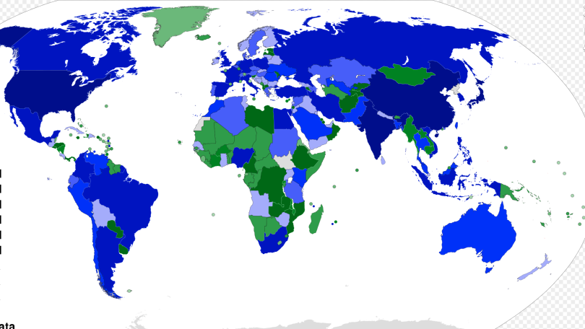
Readers by Country & Regions
Cook Islands: 32
Central African Republic: 29
St. Barthelemy: 29
Guinea-Bissau: 25
Eritrea: 22
Montserrat: 20
Sao Tome & Principe: 20
St. Helena: 19
Isle of Man: 16
Marshall Islands: 16
Mayotte: 15
Nauru: 14
Western Sahara: 14
Falkland Islands: 11
Tuvalu: 10
Aland Islands: 5
British Indian Ocean Ter: 3
Niue: 3
North Korea: 3
Svalbard & Jan Mayen: 3
Norfolk Islands: 2
St. Pierre & Miquelon: 2
Antarctica: 1
American Samoa: 93
St. Martin: 91
Vanuatu: 88
Mauritania: 86
New Caledonia: 80
Congo- Brazzaville: 67
Palau: 62
Turkmenistan: 62
Northern Mariana Islands: 57
Equatorial Guinea: 51
Timor Leste: 50
Faroe Islands: 48
Tonga: 43
Chad: 42
Comoros: 40
Kiribati: 38
Micronesia: 38
Greenland: 37
San Marino: 36
Liechtenstein: 34
French Guiana: 33

Slide 19
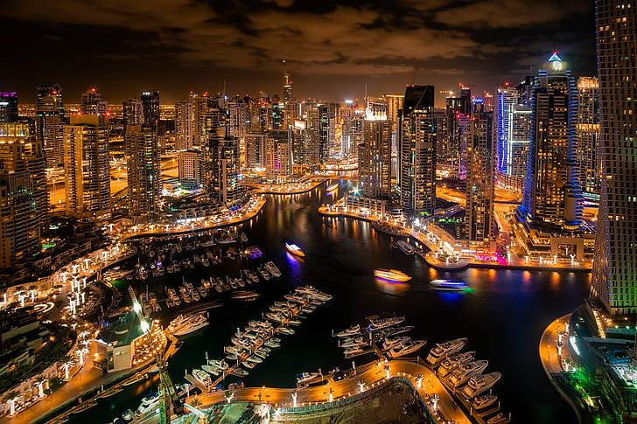
Readers by Cities
Frankfurt: 88,772
Washington DC: 76,605
London: 79,360
New York, NY: 69,582
Duesseldorf: 64,294
Los Angeles, CA: 43,524
Roseville, CA: 40,016
Chicago, IL: 39,735
Ashburn, VA, USA: 38,640
Las Vegas, NV: 37,698
Stockholm: 34,162
Honolulu, HI 31,087
Singapore: 25,133
Houston, TX: 22,178
Dallas, TX: 22,164
Seattle, WA: 21,482
Boston, MA: 21,072
Charlotte, NC: 20,006
Frisco, TX: 19,688
Madeira: 19,494
Newcastle upon Tyne: 19,326
Dubai, UAE: 18,771
Atlanta, GA: 18,654
Phoenix, AZ: 18,419
Philadelphia, PA: 18,350
Orlando, FL: 17,524
Denver, CO: 17,500
Bangkok: 16,883
Austin, TX 15,476
Nairobi: 15,239
Dar es Salaam: 14,464
San Francisco: 13,713
Toronto: 13,452
San Diego, CA: 13,141
Columbus, OH: 13,053
Portland, OR: 12,923
Sydney: 12,919
Nashville, TS: 11,064
Quezon City: 11,126
Cape Town: 10,131
Shanghai: 10,006
Sacramento, CA: 9,947
Sandton: 9,945
Miami, FL: 9,885
Tampa, FL: 9,634
Milan: 9,469
San Antonia, TX: 8,813
Kansas City, MO: 8,848
Kingston, Jamaica: 8,217
Johannesburg: 8,176
Kuala Lumpur: 8,160
Delhi: 8,158
Paris: 8,143
Pune: 8,061
Makati: 8,056
San Jose: 7,855
Baltimore, MD: 7,680
Mumbai: 7,581
Detroit, MI 7,357
Lagos: 7,329
Madison, WI: 7,251
Changsha: 7,199
Bengaluru: 7,068
Dublin: 7,068
Springfield, MO 7,024
Pretoria: 6,987

Slide 20
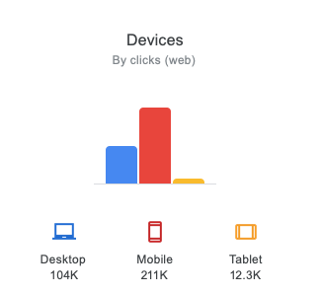
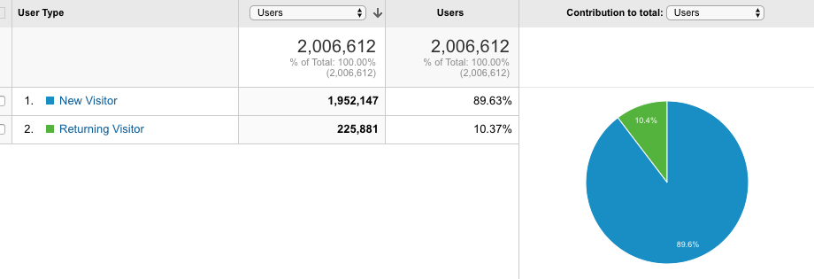
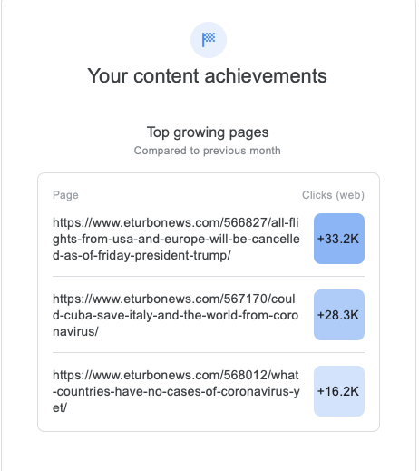

Analytics
`

Slide 21
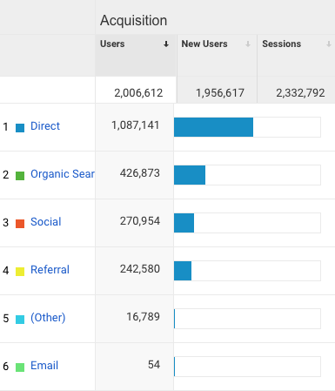
Acquisition
Analytics
`

Slide 22
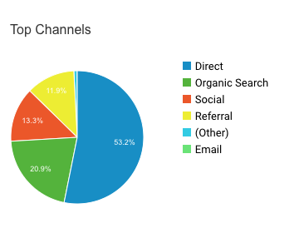
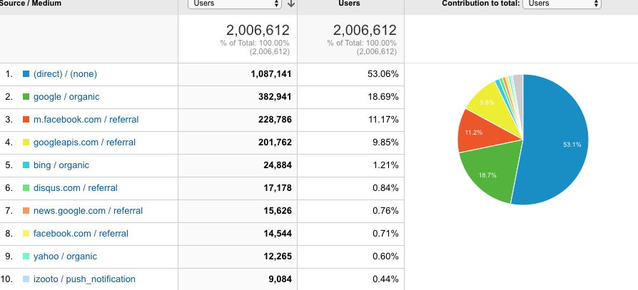
Traffic Analytics
`

Slide 23
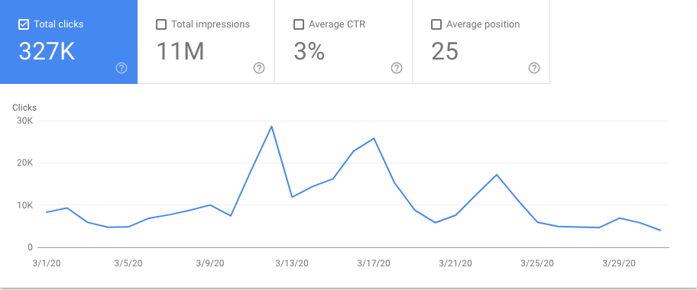
Click Analytics
`

Slide 24
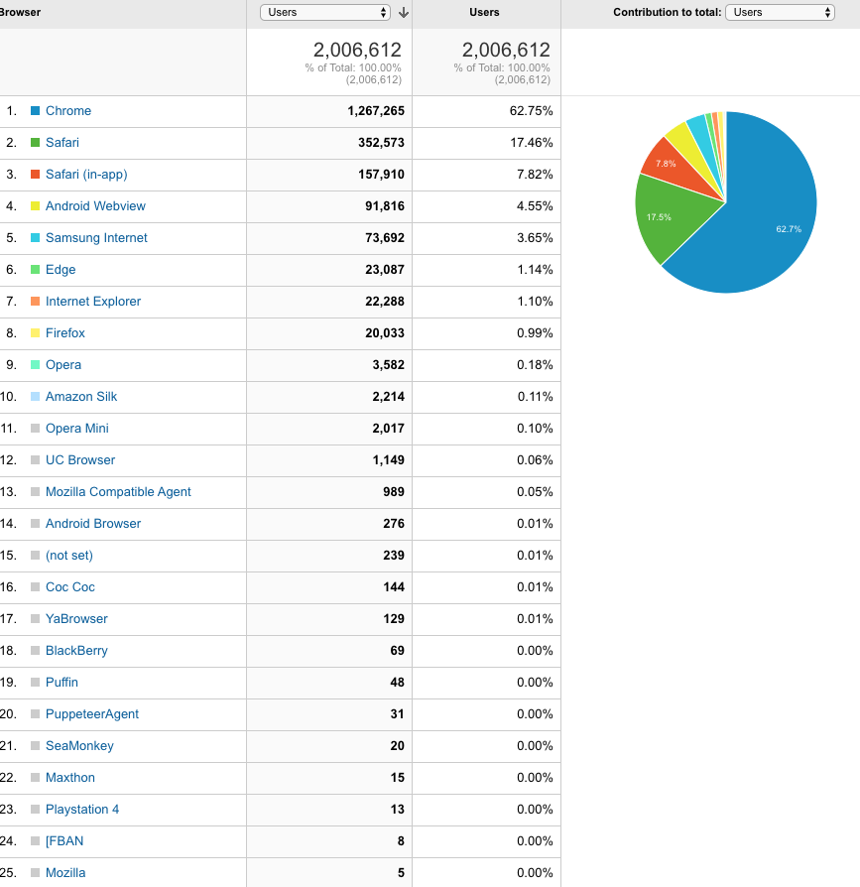
Browser Analytics
`

Slide 25

Happy Clients
Tourism Authority of Thailand
Bahamas Tourism Board
Indonesia Tourism
Seychelles Tourism Board
Vanilla Island Tourism Organization
Brunei Tourism
Guam Tourism Board
Jordan Tourism Board
Hawaii Tourism Association
Saudi Ministry of Tourism
Saudia Airlines
Etihad
California Tourism
City of Baden Baden
IIPT
Sandals Resorts
ACE MICE
OTDYKH
ECPAT
Simpleview
Finpartners
Edeman PR
Malta Tourism Board
Nepal Tourism Board
Bhutan Tourism
Hong Kong Tourism Board
Cape Town Tourism Board
Jamaica Tourism Board
Jamaica Minister of Tourism
Bahrain Convention Center
JATA Japam Tourism Expo
Jetwings Sri Lanka
Rajasthan Chief Minister
City of Damyang, S. Korea
Zimbabwe Minister of Tourism
Korean Tourism Board
Uganda Tourism Board
Sri Lanka Tourism Board
Maldives Marketing and PR Corporation
Seychelles Minister of Tourism
Seychelles Tourism Board
Czech Tourism
Meet Puerto Rico
Reunion Tourism
IGLTA
Croatia Tourism Board
St. Kitts Tourism
Roadtrips
Trinidad & Tobago Tourism
Antigua Tourism
SKAL
IMEX
World Travel Market (Reed)
Kenya Tourism Board
Agoda
Centara Hotels & Resorts
Outrigger Hotels & Resorts
Hilton Hotels & Resorts
Corinthia Hotels
Marianas Visitors Authority
Charley’s Taxi Honolulu
World Travel & Tourism Council (WTTC)
PATA
TTG Asia
Dresden Marketing GmbH
Premier Travel Magazine
Hawaii Visitors and Convention Bureau

Slide 26

SMART SYNDICATION
We write and syndicate feature news stories to 2,500+ local and national media outlets, but we will always ensure original critical coverage without destroying your reputation among publications, bloggers, and journalists.
Media placement of your story in local news outlets that consumers read and trust, generating tons of local news clips you can share to excite and inspire your current and potential customers, vendors, employees, sales teams, and more.
An initial and detailed report with links to your story will be provided within days of placement. If this expected reach cannot be achieved, we will rewrite and repeat stories produced by us.

Slide 27
Our Unique 3-Step Syndication Approach
Our syndication works differently and smartly to avoid multiplication, especially in label content Google duplicates.
FIRST STEP:
Our focus is on publications we own and control
Our first focus is positioning your story on eTurboNews and our publications (in-house syndication). Only once this is successful also in the search world, we go to step TWO
SECOND STEP:
Partner publications
We will create an alternate story with the same essential message and content and push it to relevant contract publications. Travel News Asia, Hindustan Times, selected TTG publications, and Business Travel are some of our partners. There will never be a duplication penalty, so your story is unique and prominent on all partner platforms, also for the search engines (Google)
THIRD STEP:
News Aggregators and Wire Services
Only after your story has been prominently positioned twice will we work on creating a third version to include selected mass aggregators with a proven track record, such as EIN, Business Wire, US News, and Cision, among others.
This will get your third independent version of your story on some of the most known name brands in media, such as AP, Yahoo Finance, NBC, and many more.
It will also generate the glossy reports companies such as EIN or PR Newswire are famous for.
Our focus is on helping you keep ownership of your story and not destroy your reputation with mass content that a serious journalist would never look at.

Slide 28

Bloody Good News
… for travel brands with a story to tell
A Bloody Good Story
Review, Research, Rewrite, Interview
Production of a unique Bloody Good News Story or press release
Post to eTurboNews, Syndication, and pitched to media partners
Internal and external links to the story
Wire Service distribution
Google / Bing News and others
Search engines
A lead story in e-newsletters
Social media posts and human engagement
Discussion in chat groups
$750.00
12 postings $6,750.00

Slide 29

Earned Media
Earned Media Is NOT Free
If you were compensated as a PR professional to pitch your news to eTurboNews or to any of our publications, we strongly suggest you use our commercial partner options
If we do find earned media content timely and newsworthy and publish it without compensation, an Earned Media Alert and Paywall may be added to your article to inform our readers your content was not fact-checked and may be promotional.
It’s essential for eTurboNews to be part of the earning process

Slide 30
Included in press-release postings
Excerpt
Spell & Grammar Check
One feature photo or logo
One internal link
One outgoing link
Search engine submission with index guarantee.
News aggregator submissions, such as Google and Bing News
Translated and included on our 100+ independent and searchable language news portals
Quote
About Statement
SEO check (keyphrase, keywords, headline, excerpt) and adjustment for better searches and openings:
News portal (Frontpage) inclusion (must be relevant travel-related content):
Additional photos and/or a YouTube-embedded link
Included on the eTN email newsletters to 180,000+ travel industry subscribers (for travel-related postings only)
Included in push notifications to the screen of 200,000+ subscribed web users:
Text converted to Audio and YouTube Versions and submitted to Video and Podcast search engines
Submitted to Social Media and Chat Groups, such as Facebook, LinkedIn, Instagram, X, Telegram, WhatsApp, etc:

Slide 31
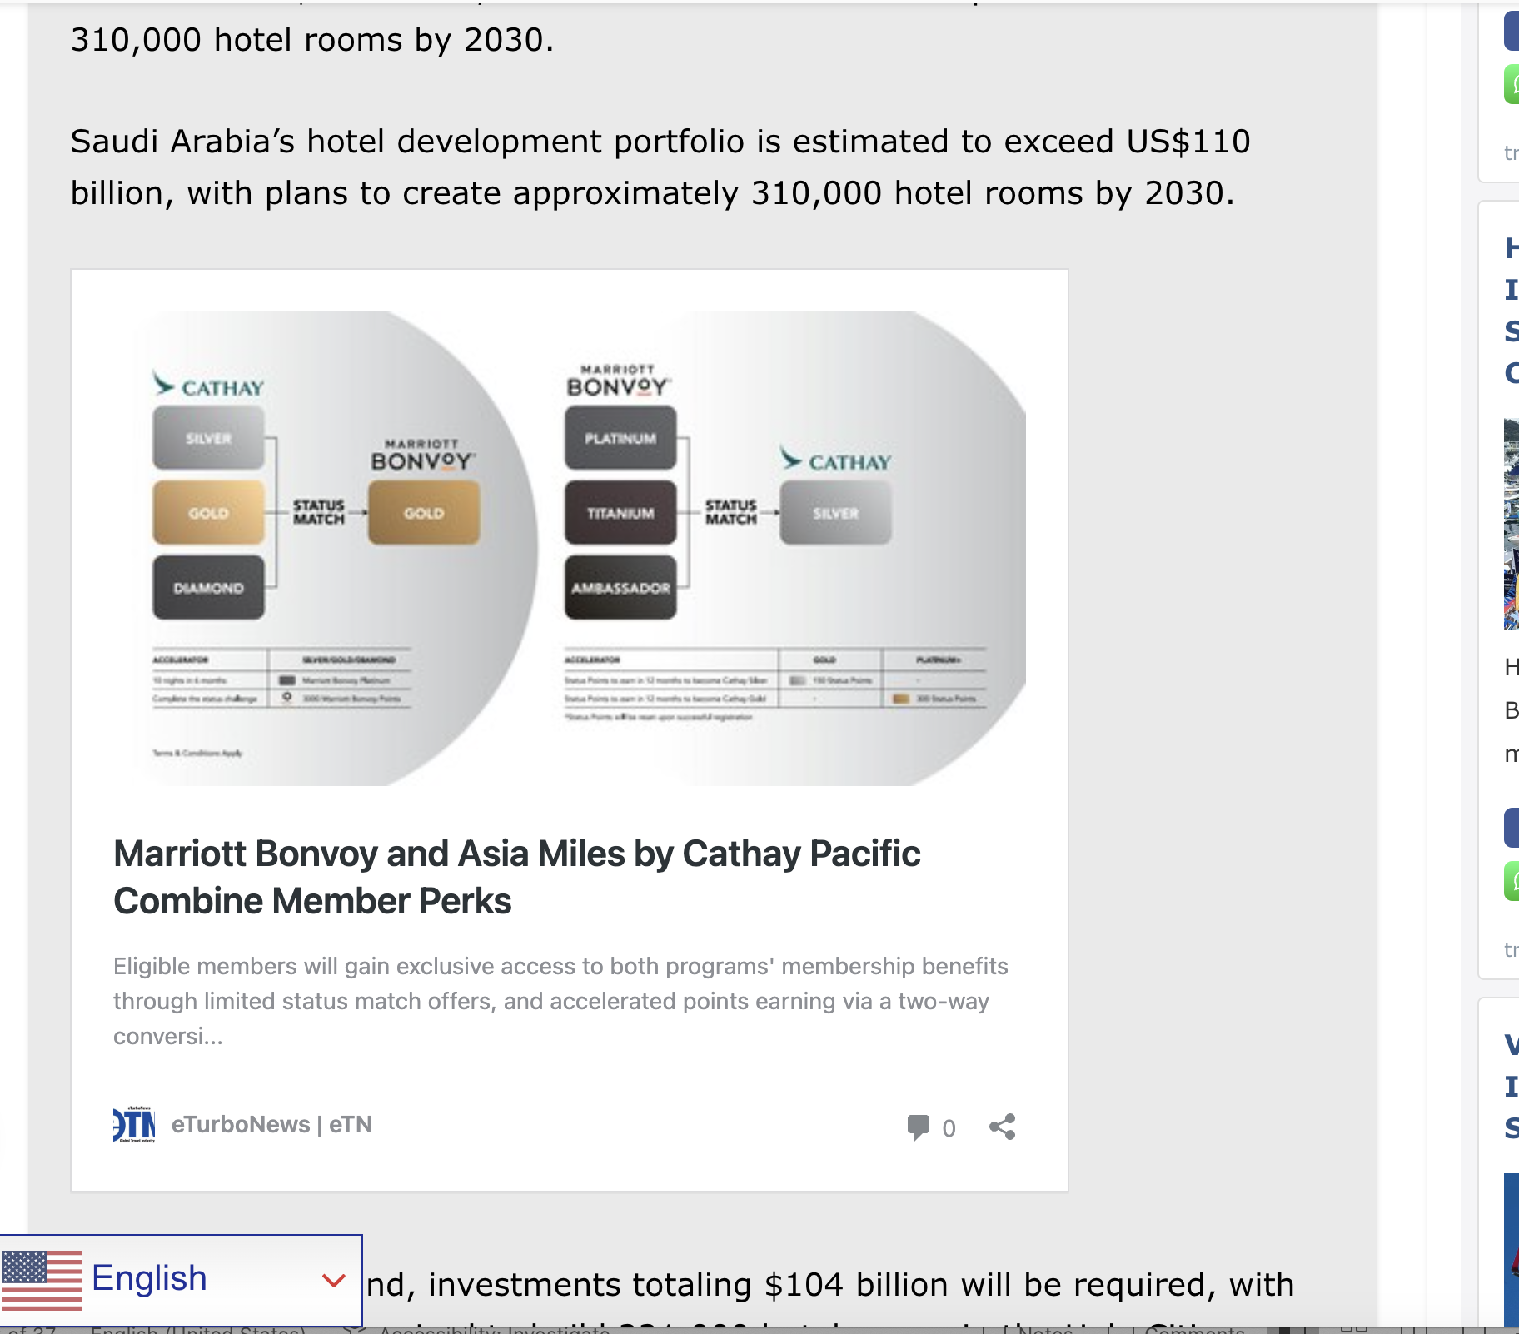
Embedded Crosslinks
How can we dramatically increase your press release’s effectiveness by multiplying the number of viewers and, at the same time, increasing the shelf life of your release up to 100 times?
>>>>Embedded crosslinks!<<<<
Your Marriott press-releases embedded in another eTN Article – for example.
You can purchase up to 100 embedded crosslinks per release or article to multiply your exposure.

Slide 32

Targeted Syndication:
Not quantity but quality
We work with the best in PR and media contacts established over the last 25 years to introduce your story to the most relevant and significant publications for inclusion, interviews, and consideration. This is done by a team of experts in this field, not mass emailing or electronic pitches. The key here is not quantity but quality and your footprint in the public domain. This approach is a mix of consulting and outreach.
This option is only available for pre-screened clients and relevant news that could make an impact. It's not for mass production but for quality exclusive news pitches.

Slide 33

Email – blasts
Included in your email blast:
Your private email to our global audience of 138,000+ travel and tourism professionals worldwide.
A free follow-up email to everyone who did not open your original email within 48 hours
A different free follow-up email will be sent to those who had opened your original email message.
Push alert with a link to your email showing on the computer screen of up to 450,000 eTN readers. It has the potential to be seen by 2+ million readers.

Slide 34

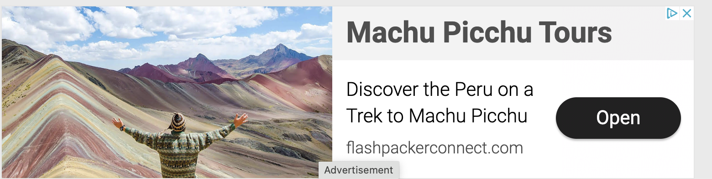

Banners, Text Links & Take Over Campaigns

Slide 35
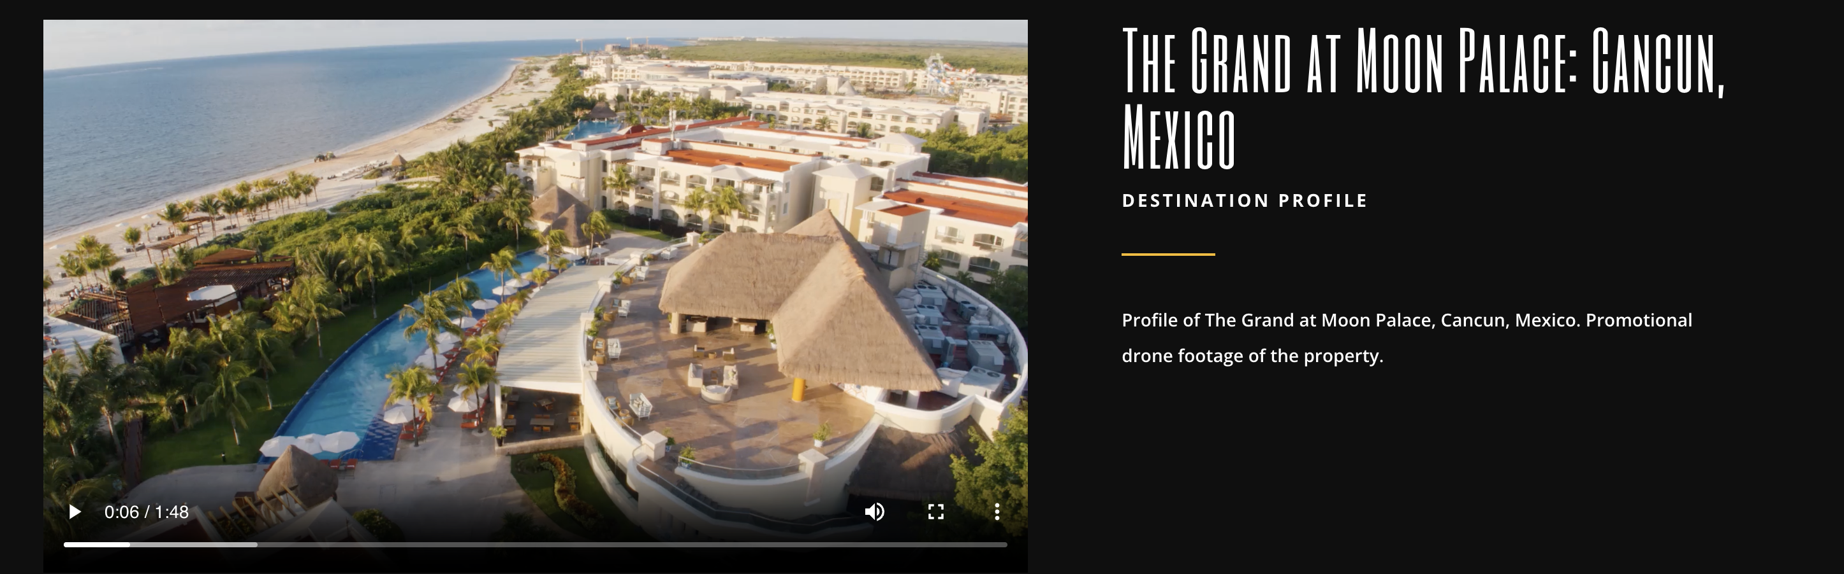


Promotional Videos & Sliders
Media in Motion

Slide 36

Award Winning Documentaries & Short Film Production
Short documentaries and narrative stories/short films.
Film tourism—choosing travel destinations based on where movies, TV series, and video content were filmed—is rapidly gaining popularity and shaping commercial tourist offerings.
A striking example is New Zealand, where “The Lord of the Rings” fans flock to visit the iconic locations featured in the films. This phenomenon significantly boosted tourism, with annual visitors increasing from 1.7 million in 2000 to 2.4 million in 2004—a remarkable 40% rise.

Slide 37


Action Plan for The Ageless Traveler
Design and Sensory Accommodation
Education, Awareness, Technologies
Staff & Management Training - Age Awareness
Marketing and Outreach: Phrases, Websites, Images, Approach
Artificial Intelligence, Technology, Data
Ageism and Attitudes
Employment Practices
Itinerary Building and Sustainability
Inclusivity
Advocacy
Certification as Age Friendly

Slide 38
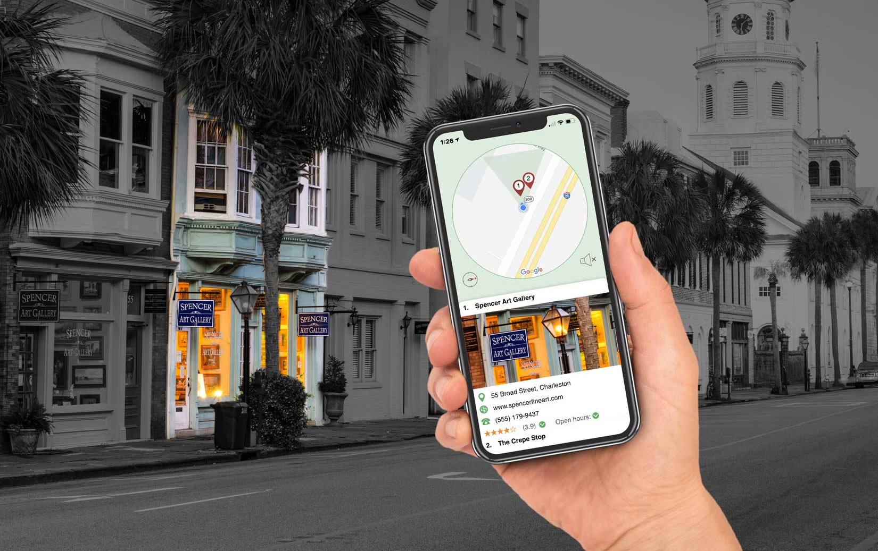

What if you could Point your Phone and Click on the real world?

Slide 39

The point at a L
For Tourism Destinations & more
Pointcast returns information on any geolocated point of interest
3
Pointcast algorithm pinpoints targeted location from geocoded database(s)
4
Pointcast returns relevant
details about location to user
2
Device sends
location & sensor
data to Pointcast
1
On-the-go user points
at nearby location
39

Slide 40




PR, Marketing & Consulting

Slide 41



Contact Us
www.travelnewsgroup.com
CEO: Juergen Steinmetz
USA: +1-202-741-9600
UK: +44-203-239-3300
Australia: +61-2-8005-1444
Hong Kong: +852-8120-9450
South Africa: +27-21-813-5811
WhatsApp | Viber | Text: +1-808-953-4705
FAX: +202-741-9600
SKYPE: thomassteinmetz
corporate@travelnewsgroup.com
2310 N Henderson Ave PMB 1773
Dallas, TX 75206-7387 USA

